Slide 1

Open Technology Workshops
SPECIAL
Gaming on Linux

Slide 2







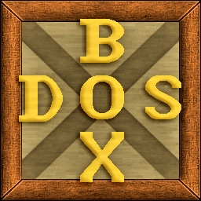


Open Technology Workshops
Retro Gaming
Mainstream Games
Game Launchers
Check For Compatibility
What can I play?

Slide 3
Open Technology Workshops
Key Packages
Package | Purpose
WINE | Allows Linux to run Windows binaries.
Proton | Basically WINE with additions and improvements to help compatibility of games.
Graphics drivers | Allow your games to take advantage of your GPU

Slide 4
Open Technology Workshops
Where to find more info
Resources for Arch Linux
A setup script (assumes Nvidia GPU) - https://github.com/sammilucia/arch-gaming
A nice guide - https://arch.d3sox.me/gaming/
Arch Wiki - https://wiki.archlinux.org/title/Gaming
Resources for Arch Linux
Dependencies - https://github.com/lutris/docs/blob/master/WineDependencies.md
Guide from The Linux Experiment - https://www.youtube.com/watch?v=v9tb1gTTbJE
Thank you for coming!

Slide 5
Open Technology Workshops
Let’s play!

